Slide 1
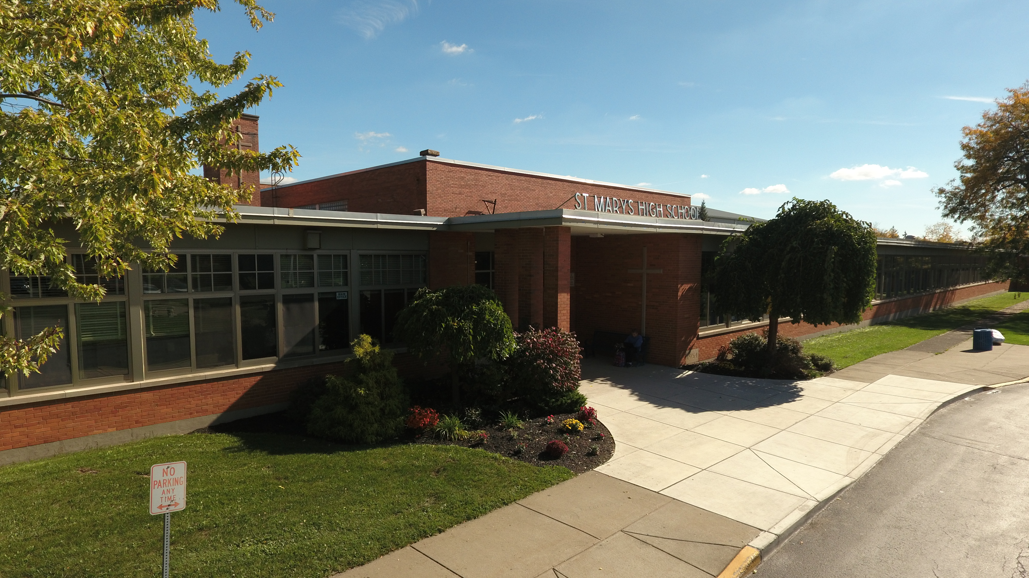
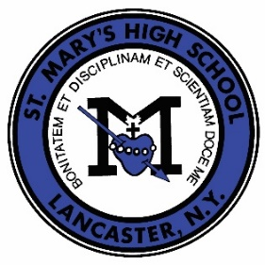
St. Mary’s High School

Slide 2
Fast Facts
Founded: 1904
City: Lancaster, NY (suburb of Buffalo, NY)
Grades: 9-12
Total Enrollment: 409
Average Class Size: 20
Student-Teacher Ratio: 14:1
Graduation Rate: 100%
AP Classes: 11
SAT Score (Top 10%): 1280
Address: 142 Laverack Avenue Lancaster, NY 14086
Website: smhlancers.org

Slide 3
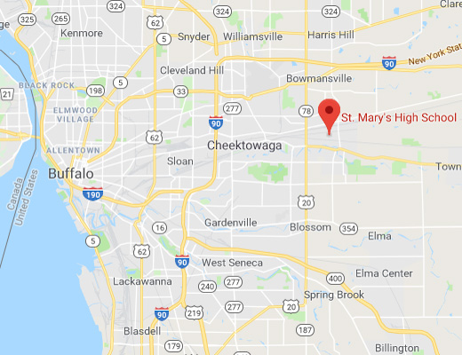
Location
Address: 142 Laverack Avenue Lancaster, NY 14086
Closest City: Buffalo, NY
  Toronto, ON – 90-minute drive
Closest University: The State University of New York at Buffalo
Airport: BUF (Buffalo Niagara International Airport)

Slide 4
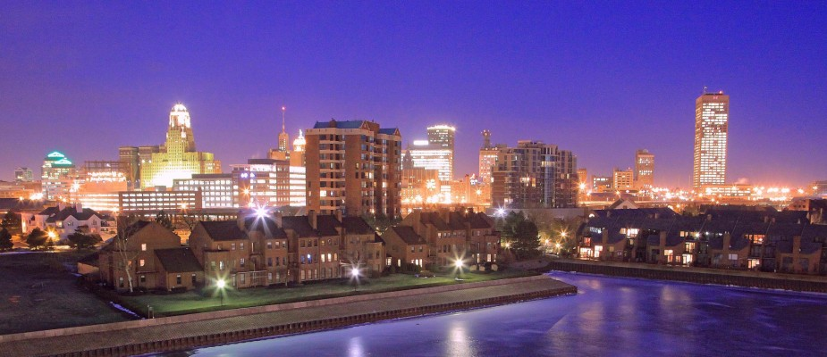
Buffalo, NY
Buffalo, NY is a city on the rise. Founded in 1825, Buffalo offers all of the history and charm of a city from the past, while incorporating all of the elements that today’s society demands of a sprawling metropolis.
Buffalo sits on the shores of Lake Erie and the Niagara River, making beaches popular destinations in the spring and summer for some fun in the sun! Canalside also offers kayaking, water bikes, and more to get out on the water. In the fall, leaves change colors on the trees to reds and oranges and activities like apple-picking and hay rides are easy to find. Buffalo does get its fair share of snow, but that doesn’t slow us down one bit! Skiing down the slopes, sledding, and ice skating are popular at this time of the year.
Buffalo also plays host to a myriad of professional and college sports teams, which make every season in Buffalo one to root for! Those professional teams include the Buffalo Bills (NFL), Buffalo Sabres (NHL), Buffalo Bandits (NLL), Buffalo Beauts (NWHL), and the Buffalo Bisons (AAA baseball).

Slide 5

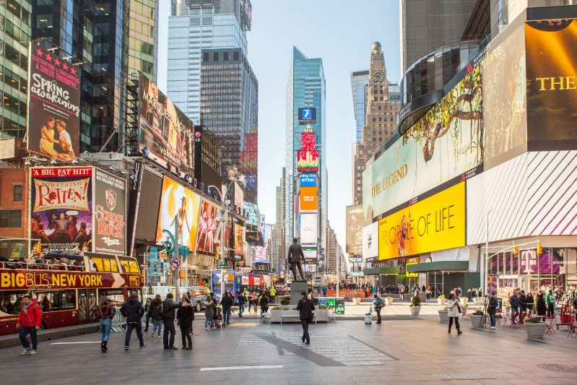


Outside Buffalo, NY
St. Mary’s is also a 20-minute drive from the Canadian border, which is your gateway to Niagara Falls - one of the true natural wonders of the world - as well as major cities like Toronto and Ottawa, offering a whole other world of experiences.
The Statue of Liberty and Times Square are also just a short plane ride away from St. Mary’s. Buffalo is within an hour from major destinations, like New York City, Chicago, and Philadelphia, which offer some of the best known and historic sites in the United States.
Academically, St. Mary’s is at the epicenter of several top colleges and universities. Right in our own backyard, the University at Buffalo has a state-of-the-art, sprawling medical campus and Canisius College boasts the number one Accounting program in the northeast. Also in the northeast, again a short ride away, are several Ivy League universities.

Slide 6
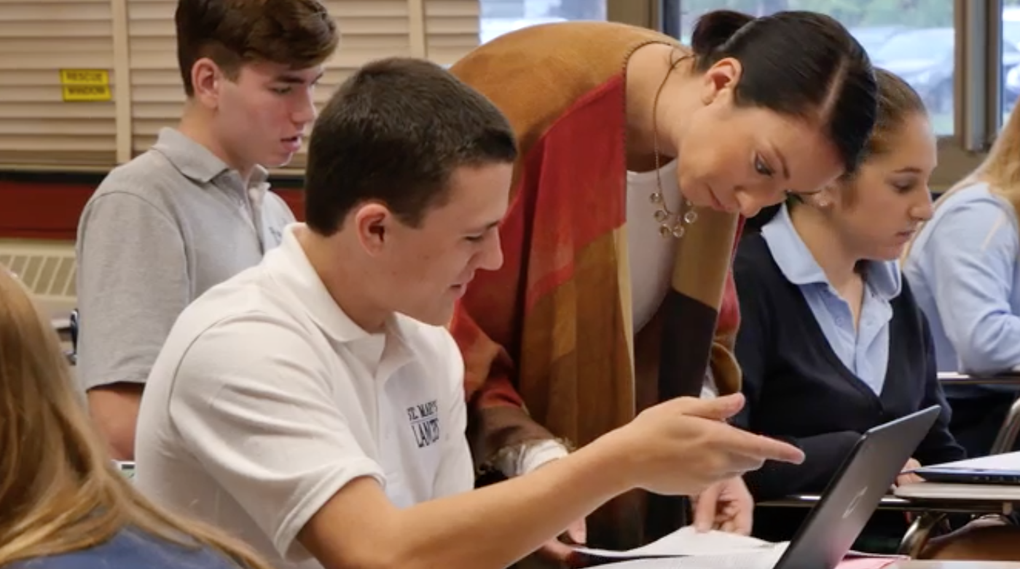
Academics
St. Mary’s is developing a life-major curriculum, in which students take courses and electives to better prepare them for life after high school. These courses include Personal Finance, Leadership Skills, and Public Speaking.
St. Mary’s is currently ranked 7th out of 134 high schools in Western New York, according to Buffalo Business First. Rankings are based off the school’s test scores on Regents exams in Math, Science, English, and History over the past several years.
Rigorous Regents and Honors courses are structured to prepare students for college. A variety of elective courses give students the chance to explore their interests for college and their career choices.
Students utilize a 1:1 Google Chromebook Program. At registration, each student will receive a Chromebook to use over their four years at St. Mary’s and then keep upon graduation.
AP classes: 11
Number of Advanced/Honors Courses: 11
AP Pass Rate (3 or higher): 60%
Average AP Score: 3.5

Slide 7
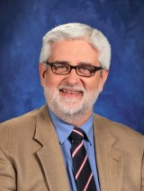
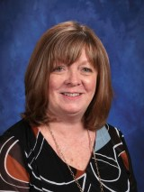
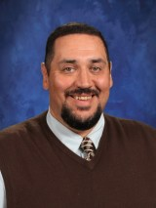
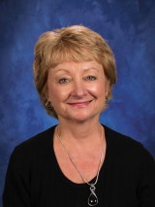
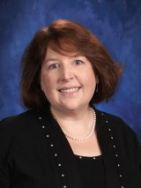
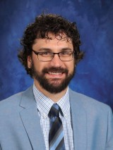
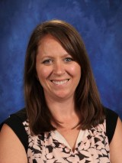
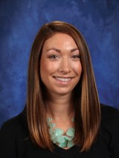
Faculty Profile
The faculty at St. Mary’s is unlike any other you will find in a high school. All teachers are certified in their given fields, but what separates the St. Mary’s faculty from others is their willingness to help their students understand the material. Teachers will stay after school, offer tutoring and review sessions, and take extra class time to ensure students have a grasp on the material. The faculty is the greatest contributing factor to what makes St. Mary’s a family.
100% of teachers have their Bachelor’s Degrees
90% of teachers have their Master’s Degrees
2% of teachers have a PhD

Slide 8
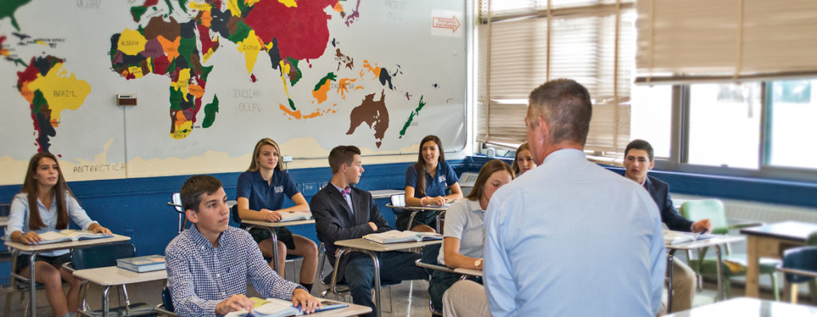
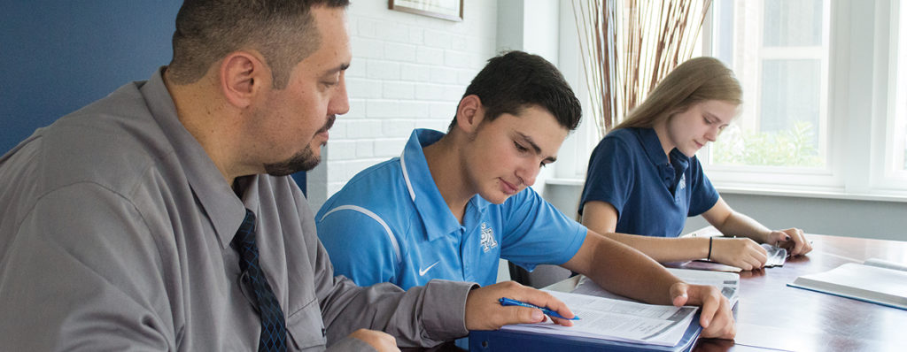
AP Classes
AP Classes: 11
  Calculus
  Statistics
  Biology
  Chemistry
  Computer Science & Computer Science Principles
  Spanish
  English Language & Composition
  English Literature & Composition
  World History
  United States History
  American Government & Politics
2018 AP Passing Rate: 60%

Slide 9
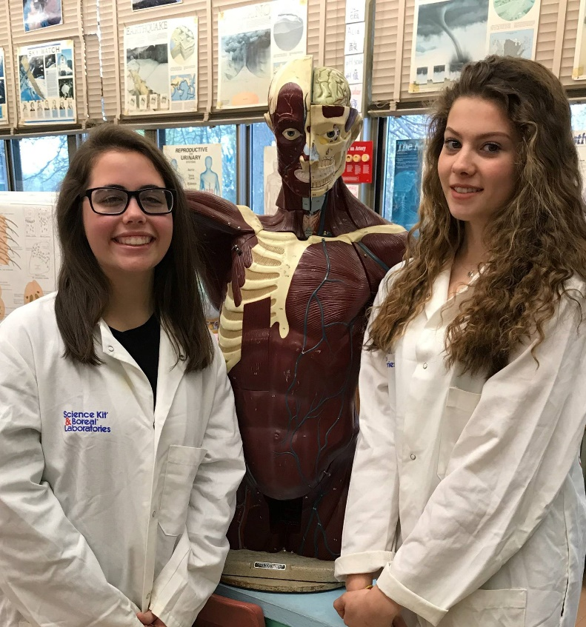
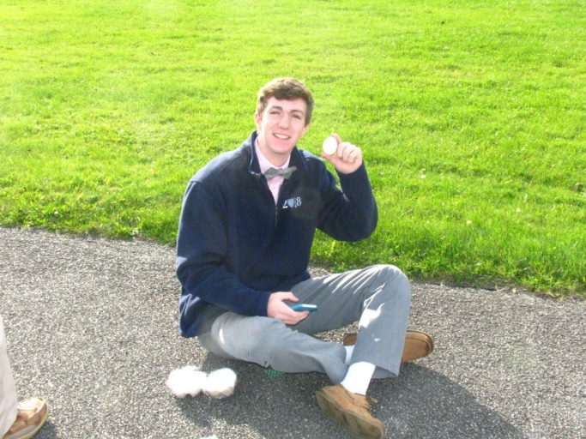
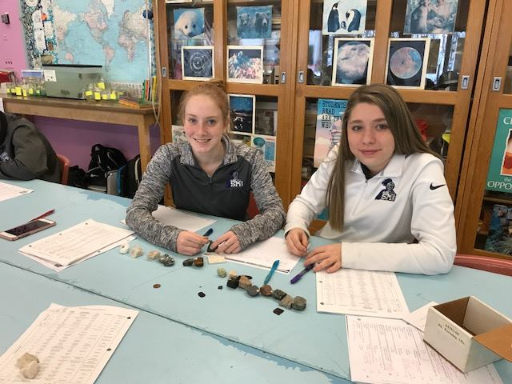
STEAM
In today’s world, Science, Technology, Engineering, Arts, and Mathematics (STEAM) is everywhere. A strong STEAM background gives students the opportunity to apply lessons to their daily lives and potentially select careers in this rapidly growing field.
Sophomores are required to register and successfully complete at least two STEAM Challenges. There are eight STEAM Challenges during the year, so students can choose the challenges they are most interested in and are welcome to participate in more than two projects.

Slide 10
Course Catalogue
Fine Arts
Art 9 (2D Design)
Art 10 (Color Theory)
Art Elective (Digital Photography, Drawing & Painting, 3D Media, 2D Studio Art)
Religion
Religion 9-12
Retreat Peer Ministry
Philosophy & Catholic Culture
Business/Computers
Accounting
Business Law
21st Century Computing
AP Computer Science
3D Computer Automated Design
English
English 9 & English 9 Honors
Reading Development
English 10 & English 10 Honors
English 11
AP English Language & Composition
English 12 – Intro to College Composition
AP English Literature & Composition
Writing Development
Creative Writing
Health/Physical Education
Health
Physical Education
Dance
Foreign Language
Spanish I-III
Spanish II Honors
AP Spanish
Math
Algebra I & Algebra I Honors
Geometry & Geometry Honors
Algebra II & Algebra II Honors
Precalculus
AP Calculus
AP Statistics
Music/Perf. Arts
Music 9 & 10
Varsity Chorus
Intro to Keyboarding & Guitar
Science
Earth Science
Living Environment A & B
STEAM
Chemistry Honors & General Chemistry
Forensics
AP Chemistry
AP Biology
Environmental Science
Physics
Social Studies
Global Studies 9 & 10
AP World History
U.S. History & Government
AP U.S. History
Participation in Government
AP American Government & Politics
Psychology
Introduction to Criminal Justice
Personal Finance
Leadership Skills

Slide 11
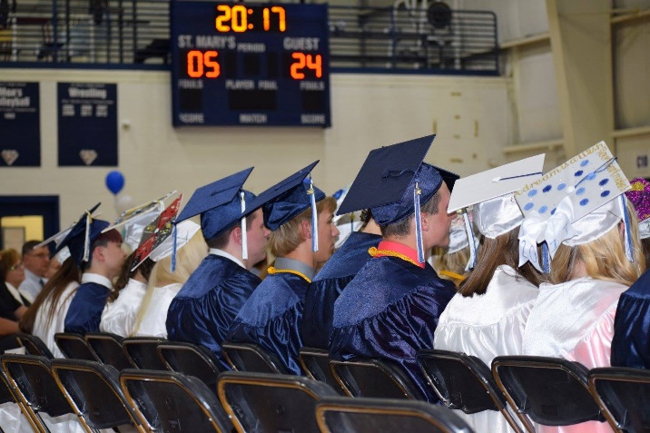
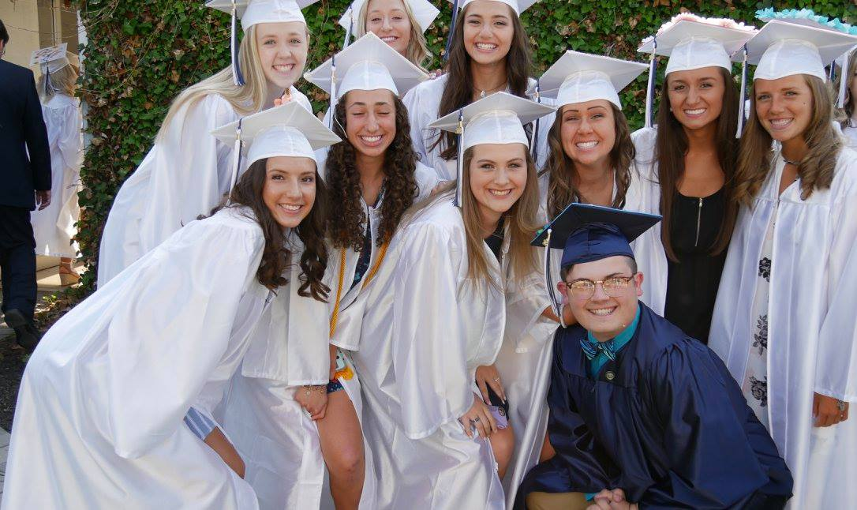
After Graduation
Notable universities/colleges St. Mary’s students have been accepted to:
Academy of Art University
Canisius College
Columbia University
Cornell University
Duke University
Georgetown University
Harvard University
Johns Hopkins University
Michigan State University
New York University
Northwestern University
The Ohio State University
Penn State University
Princeton University
SAT Score (Top 10%): 1280
Graduation Rate: 100%
Rochester Institute of Technology
St. Bonaventure University
Stanford University
SUNY Geneseo
SUNY University at Buffalo
University of Alabama
University of North Carolina at Chapel Hill
University of Notre Dame
University of Pittsburgh
University of Rochester
West Virginia University
Xavier University
Yale University

Slide 12
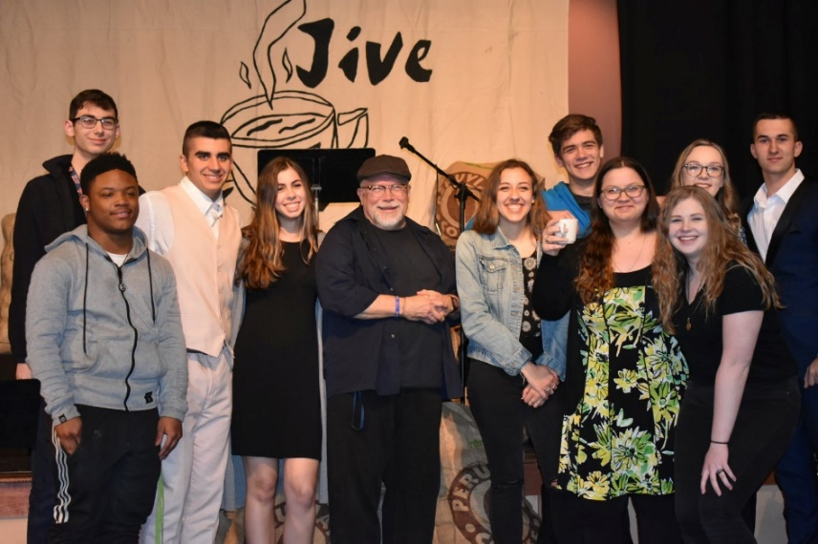
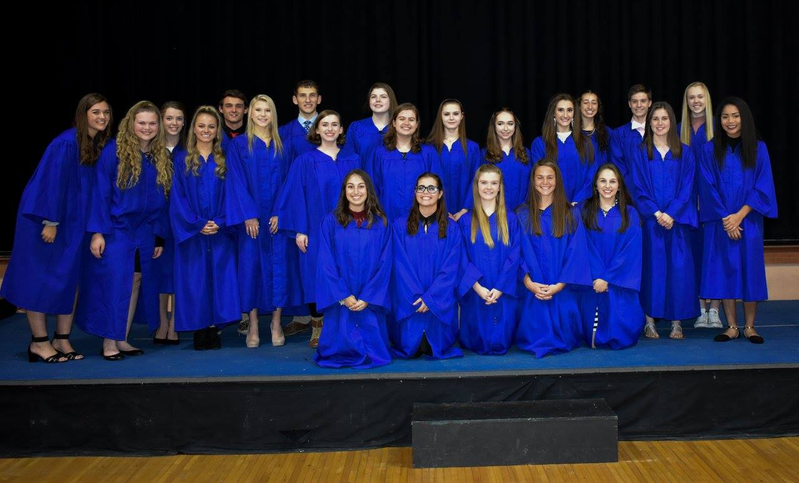
Clubs & Organizations
Art Club
Badminton Club
Board Games & Computer Club
Book Club
Dance Club
Digital Photo Club
Donate Life
Environmental Club
Equestrian Club
Glee Club
Lancer First Responders Club (LFR)
Mock Trial
Music Technology Club
Math Club
National Honor Society
Performing Arts
Praise Band
Respect Life Club
Retreat Peer Ministry
SADD
Science Olympiad
Student Senate
Yearbook

Slide 13
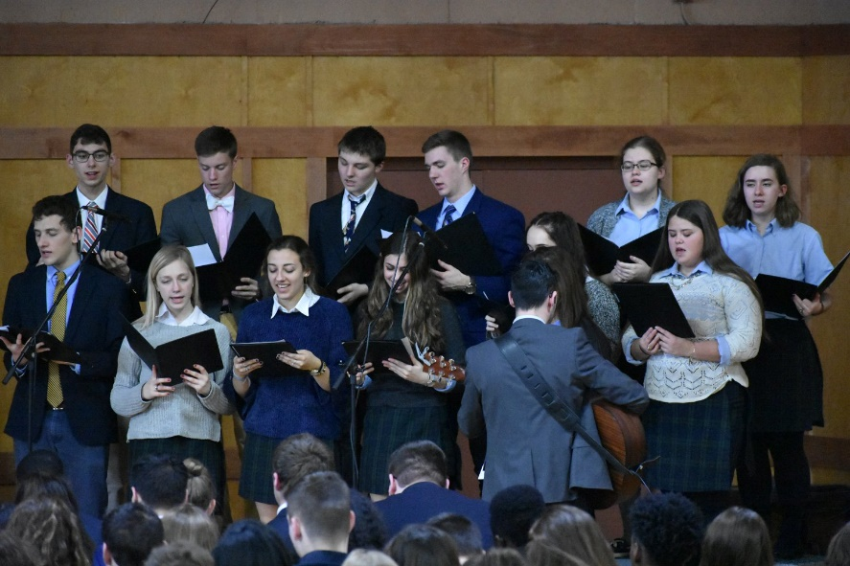
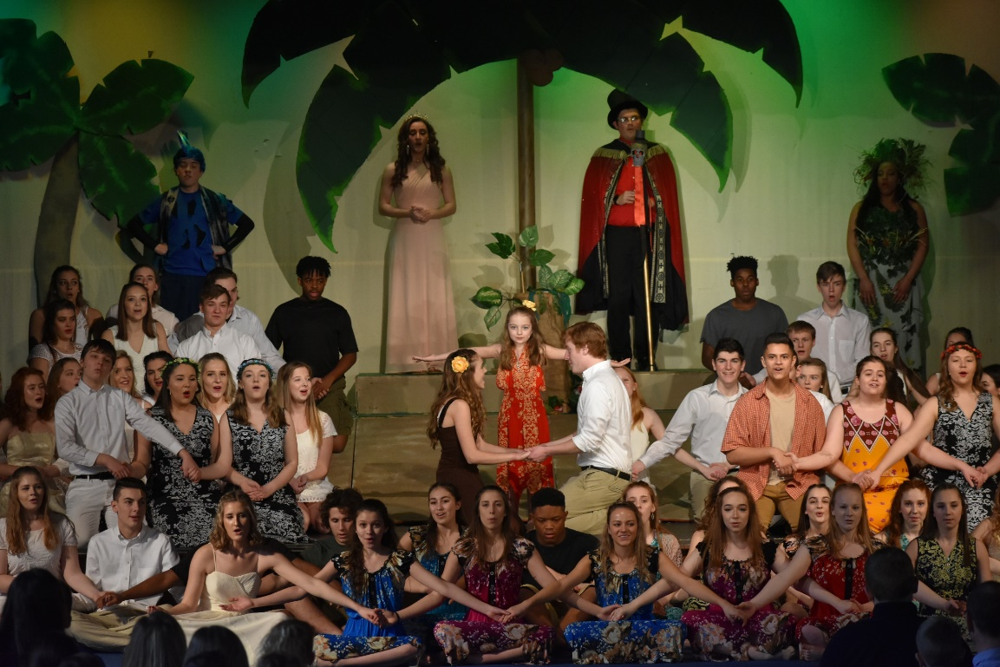
Music & Performing Arts
Courses
  Music 9 & 10
  Varsity Chorus
  Intro & Advanced Keyboarding & Guitar
  Rock n’ Roll: Popular Music in America
Clubs
  Dance Club
  Glee Club
  Praise Band
Performance Opportunities
Fall Play
Christmas Show
Spring Musical
Evening of Fine Arts

Slide 14
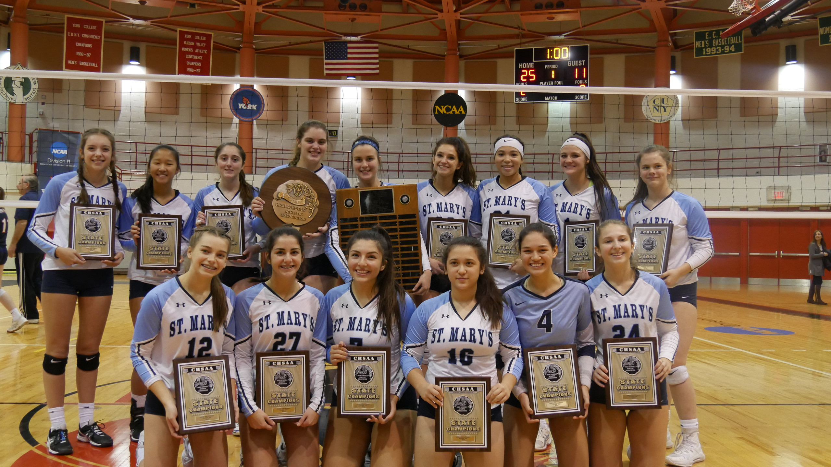
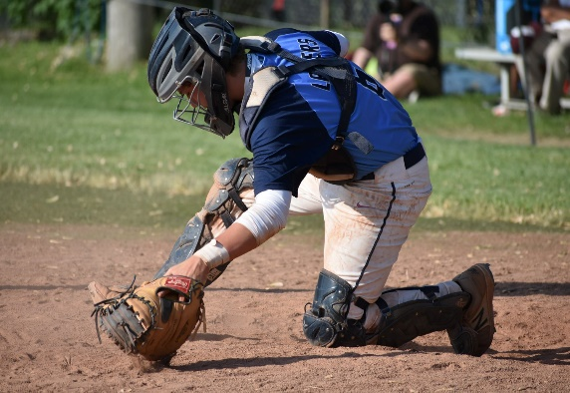
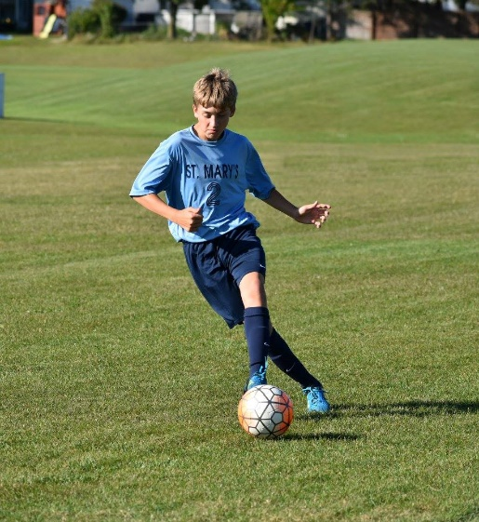
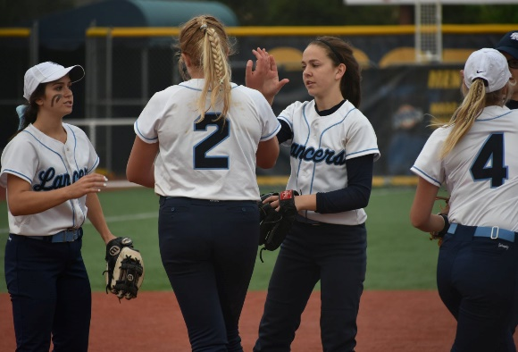
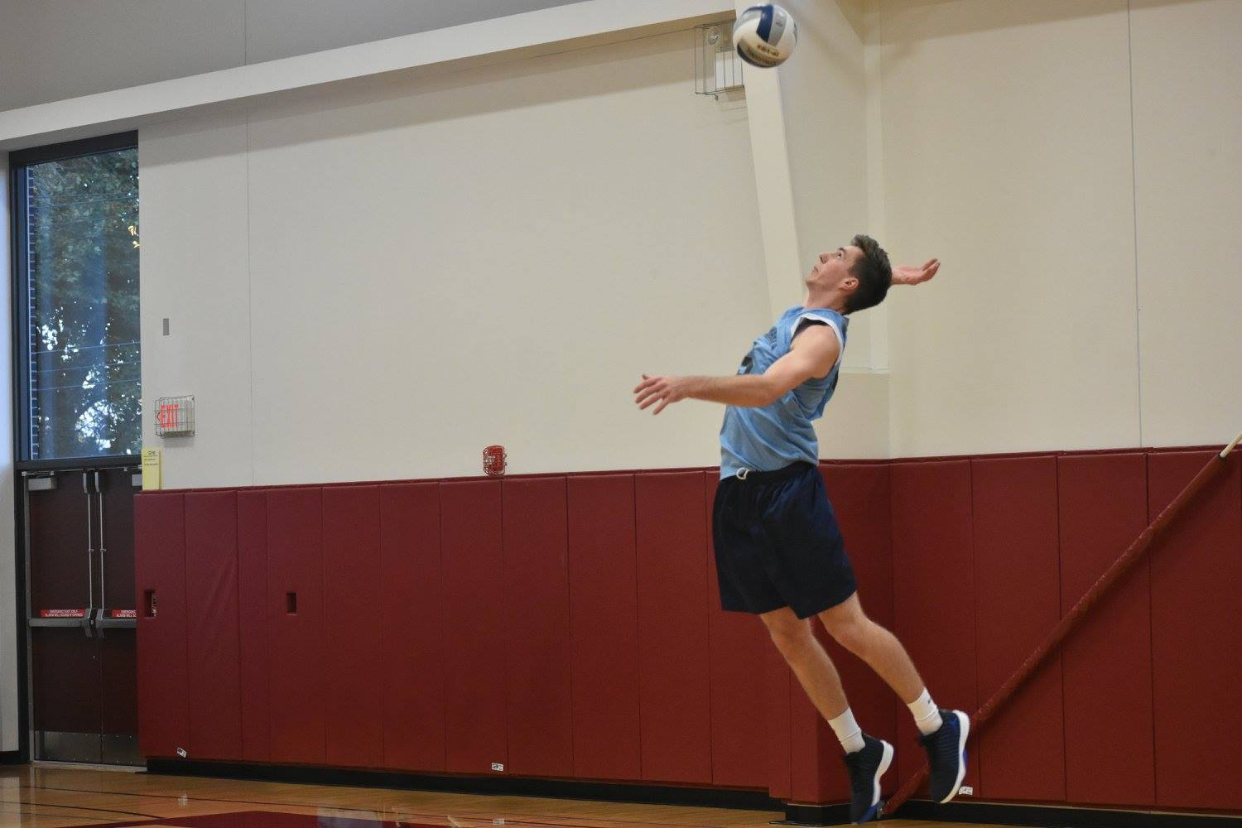
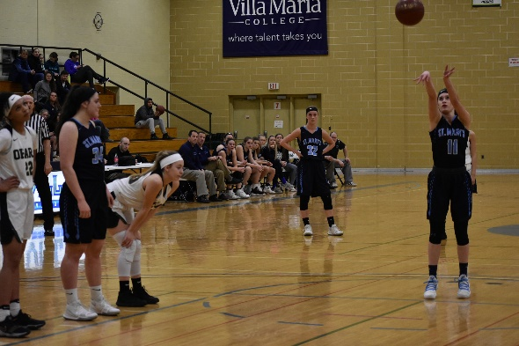
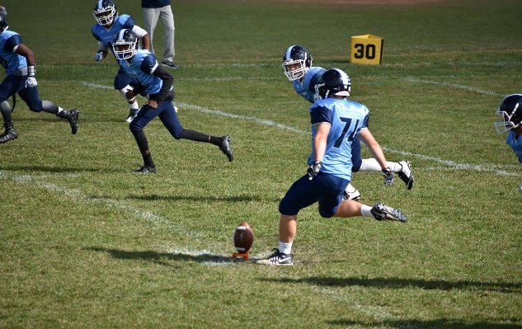
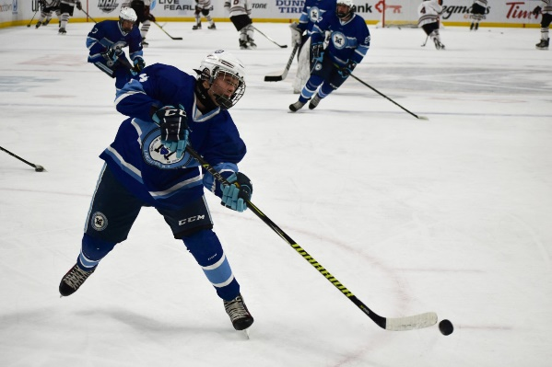
Athletics
Baseball
Men’s and Women’s Basketball
Men’s and Women’s Bowling
Cheerleading
Cross Country
Football
Golf
Men’s and Women’s Ice Hockey
Indoor Track (Club)
Men’s and Women’s Lacrosse
Men’s and Women’s Soccer
Softball
Tennis
Men’s and Women’s Track and Field
Men’s and Women’s Volleyball
Men’s and Women’s Wrestling
Championship-caliber
  2018: men's soccer, women's volleyball, golf, men’s lacrosse
  Women’s volleyball has won 8 league titles in a row and 17 state championships in total

Slide 15
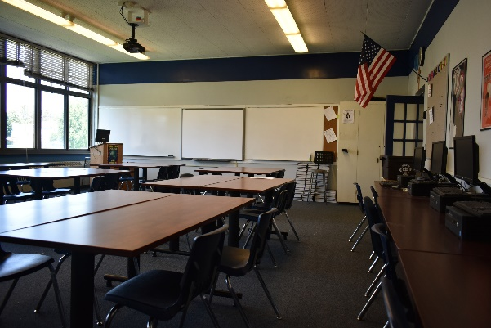
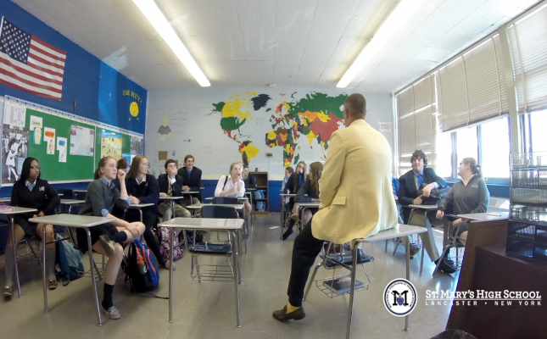
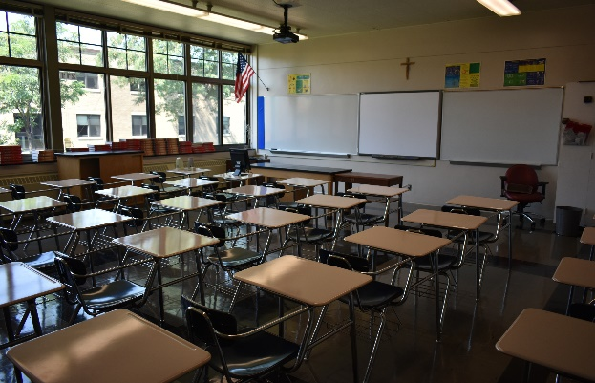
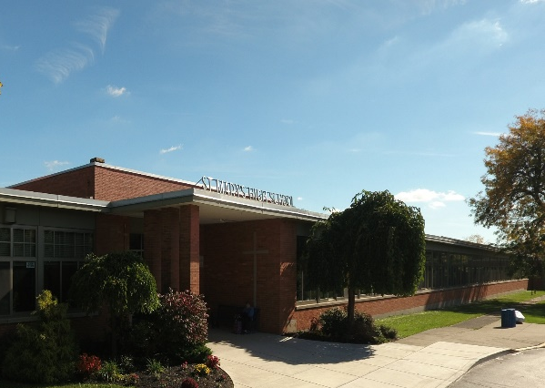
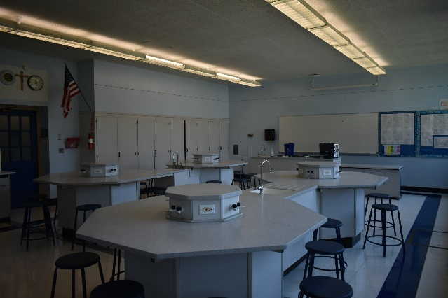
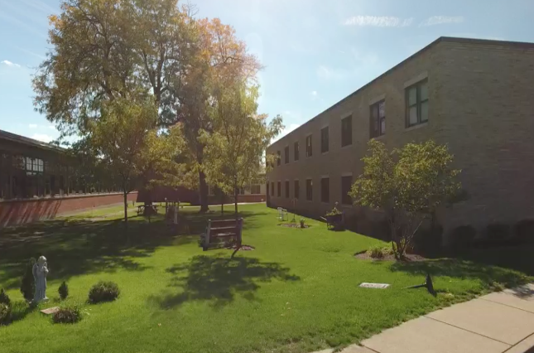
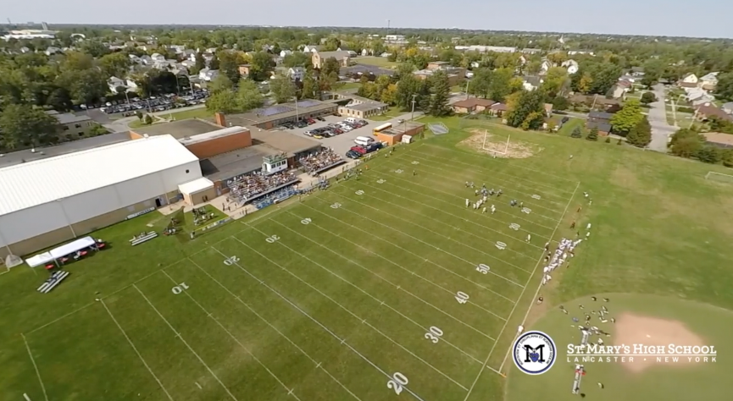
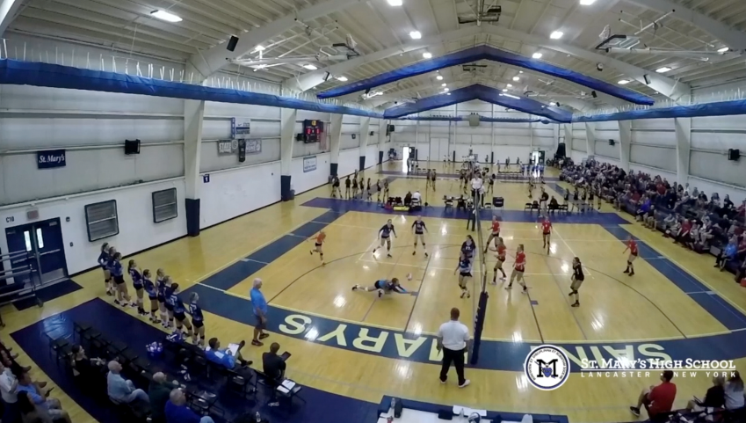
Facilities
In its current location since 1957, St. Mary’s provides all of the tools necessary for students to thrive in and out of the classroom.
All rooms are equipped with SMART Boards to better engage students in lessons
Two separate science labs allow for hands-on demonstrations and experiments
Students design and create projects of their own with a 3D printer in a computer lab
The Peter Kamsyz ʼ46 Finance Center provides state-of-the-art technology for students to dive head-first into the world of finance and economics
The Athletic Center was recently built in 2004 and is considered the preeminent facility in Western New York
Outdoor athletic fields include a synthetic turf baseball diamond and a first-class football field
An on-campus auditorium hosts all school plays, musicals, and Masses

Slide 16
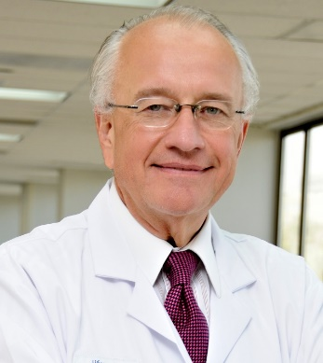
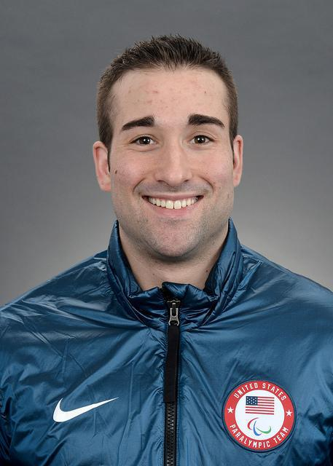
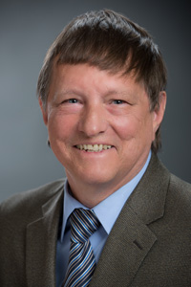
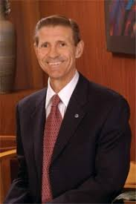
Distinguished Alumni
Dr. John Ulatowski- Vice President, Medical Affairs and Vice President, Middle East Operations at Johns Hopkins Medicine International
Adam Page- Two-time Olympic gold medalist in Paralympic Winter Games (Sled Hockey)
Dale Carlson- Professor of Patent Law at Quinnipiac University
Francis Lazarus - President of the University of Dallas

Slide 17
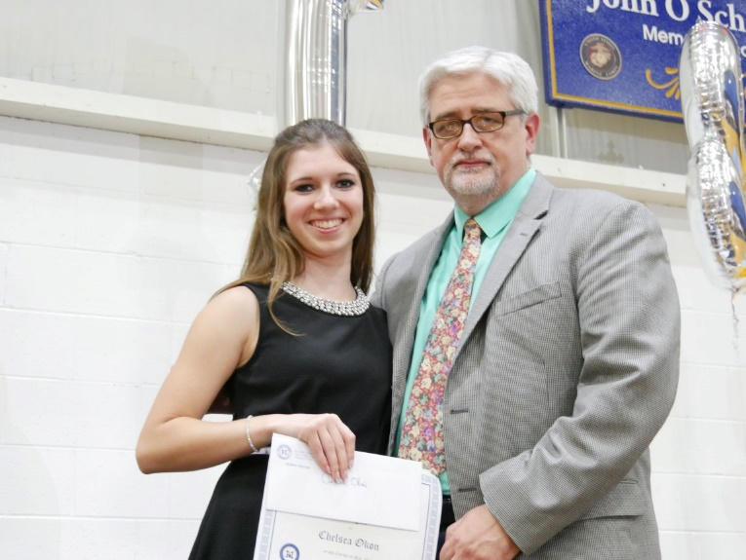
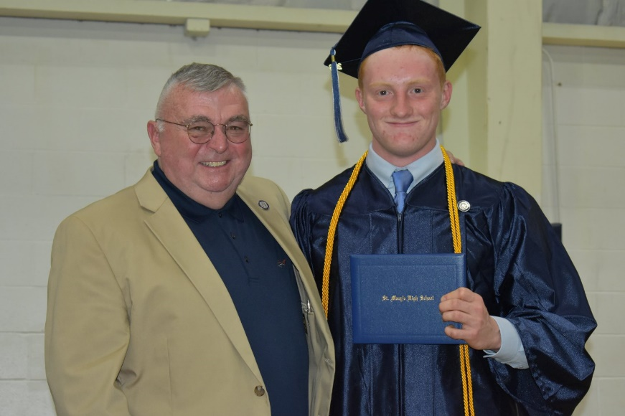
College-Preparatory
St. Mary’s prepares students for college and beyond with a “life-major” curriculum.
  Core courses to graduate (St. Mary’s is NYS Regents accredited)
  Specific electives fine-tune skills to better prepare students for the real world
    Public Speaking, Personal Finance, and Leadership Skills
St. Mary’s students also prepare for the SAT and ACT with review courses and take the PSAT as juniors.

